Slide 1
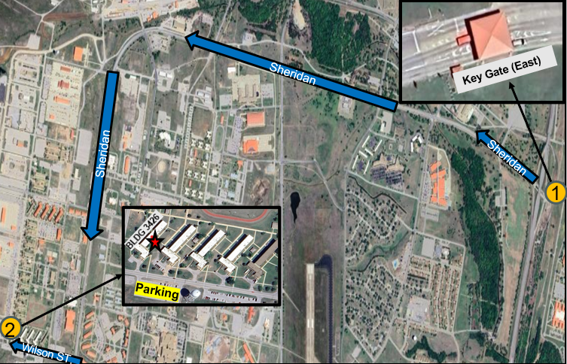
AMEDD-DCC STRIPMAP
LEGEND
ROUTE MOVEMENT | KEY GATE (EAST) | AMEDD BARRACKS
- | Route: Enter thru Key Gate (East) and stay on Sheridan Road for 3.1 miles. Turn right on Wilson Street and travel west for .3 miles, until you reach the parking lot south of building 3426. | Rally Point: Building 3426 Babcock Road Parking: Lot located on the South side of Building 3426 In Process: Check in at CQ Desk, drop bags in Room 101, and report to the 1st floor classroom (RM 112) for further instruction.
1
2
Notes:
Uniform

