Slide 1
CAO/CNO Recertification Training
http://jko.jfcom.mil/

Slide 2
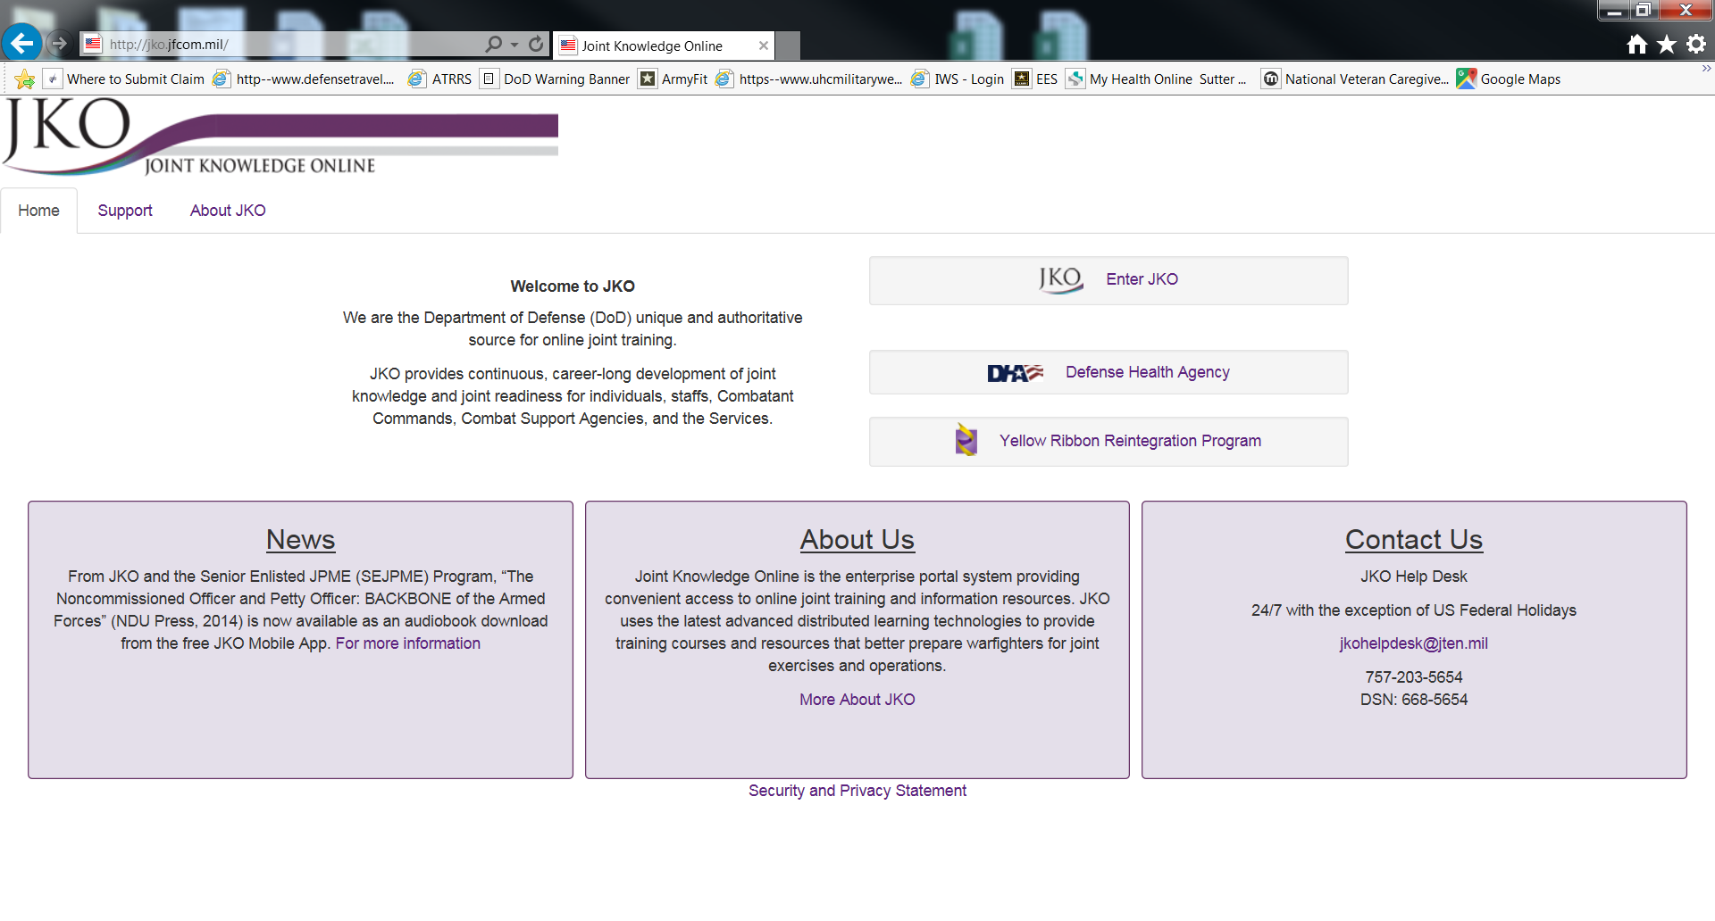

Slide 3
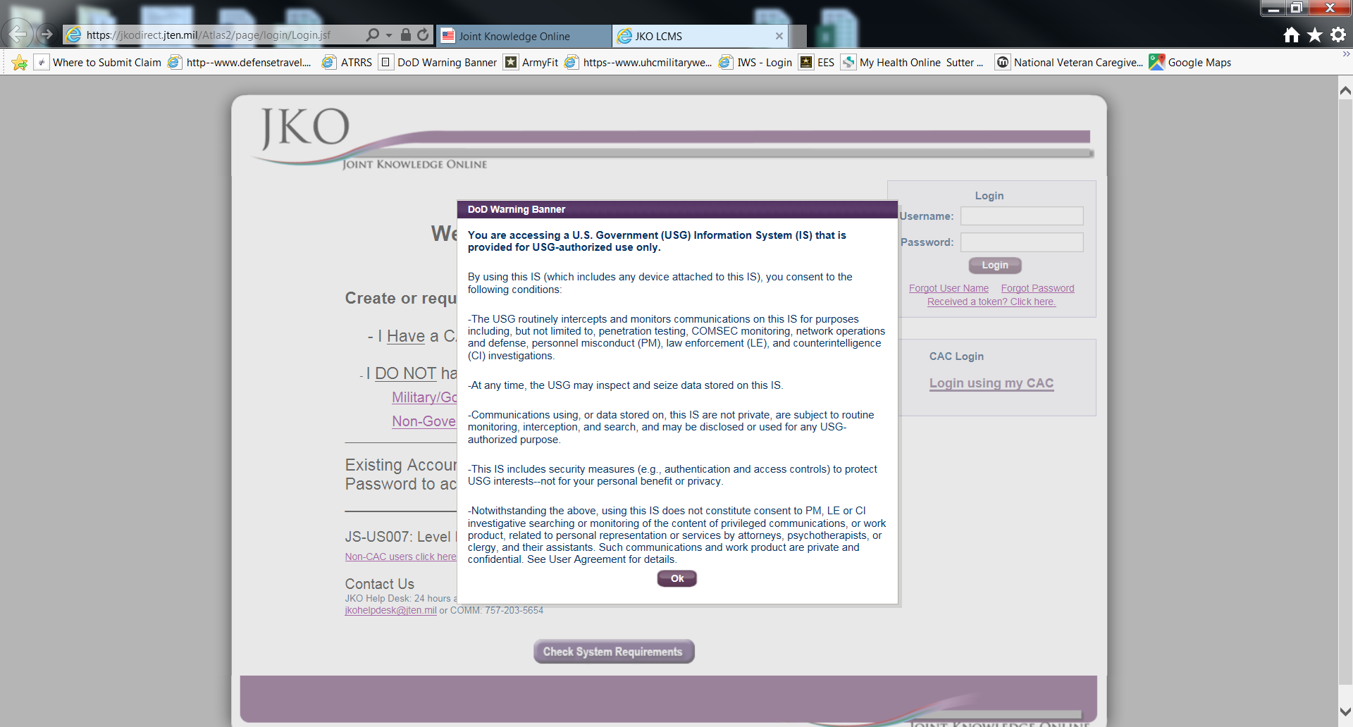

Slide 4
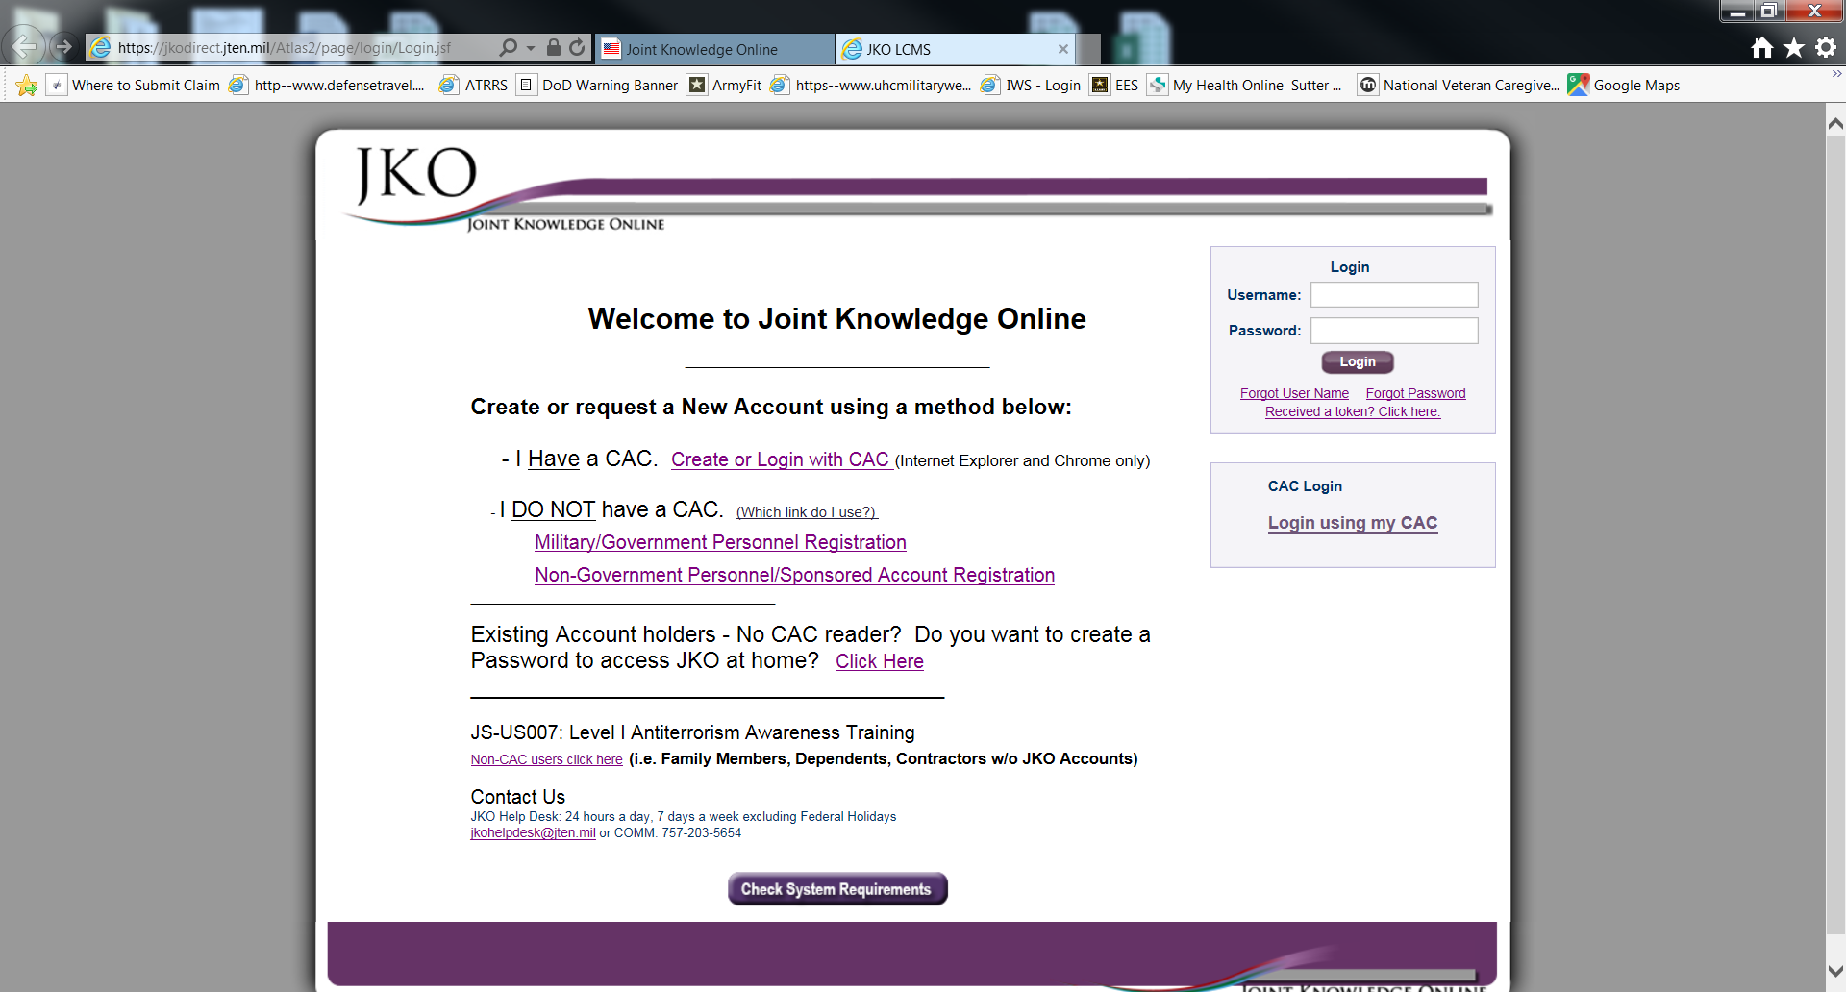

Slide 5
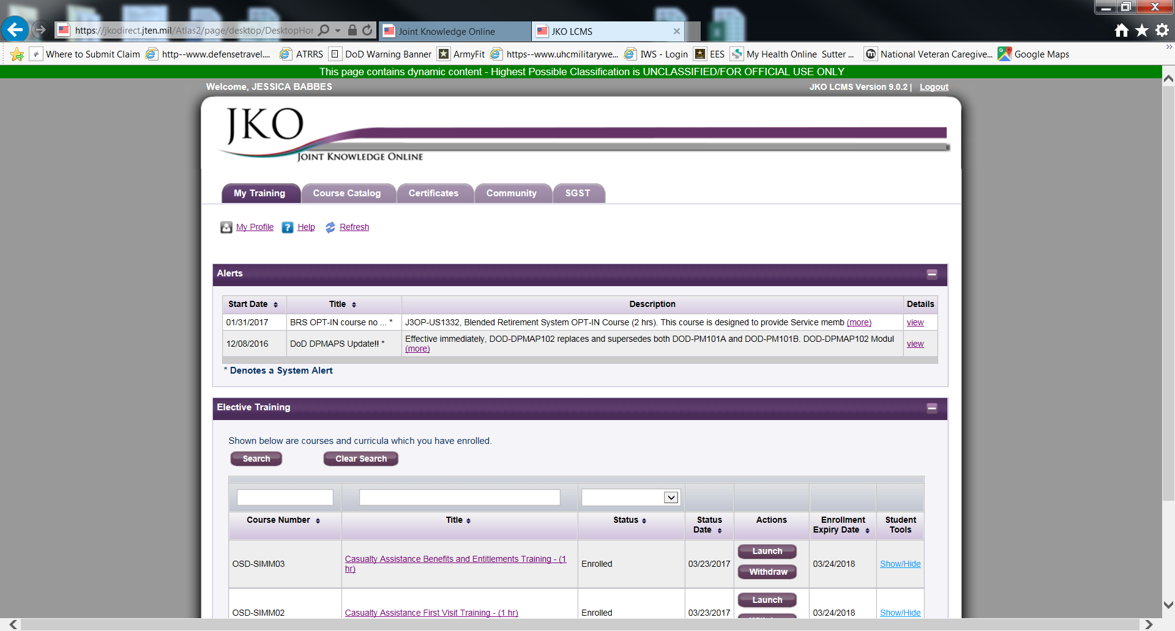

Slide 6
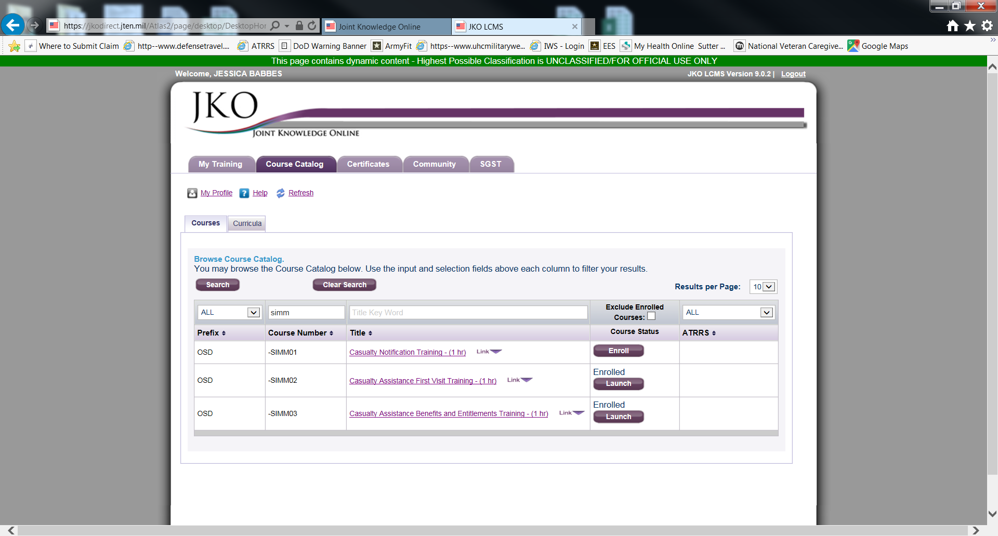
Type “SIMM” into the course number search box. Enroll into all three
courses (SIMM01, SIMM02, SIMM03). You must score 80% or more in all
three courses to pass.

Slide 7
Once you have completed the three courses, email your certificates to
Jacob.b.gamble2.civ@army.mil
usarmy.sill.id-training.mbx.ft-sill-casualty@army.mil

